Slide 1
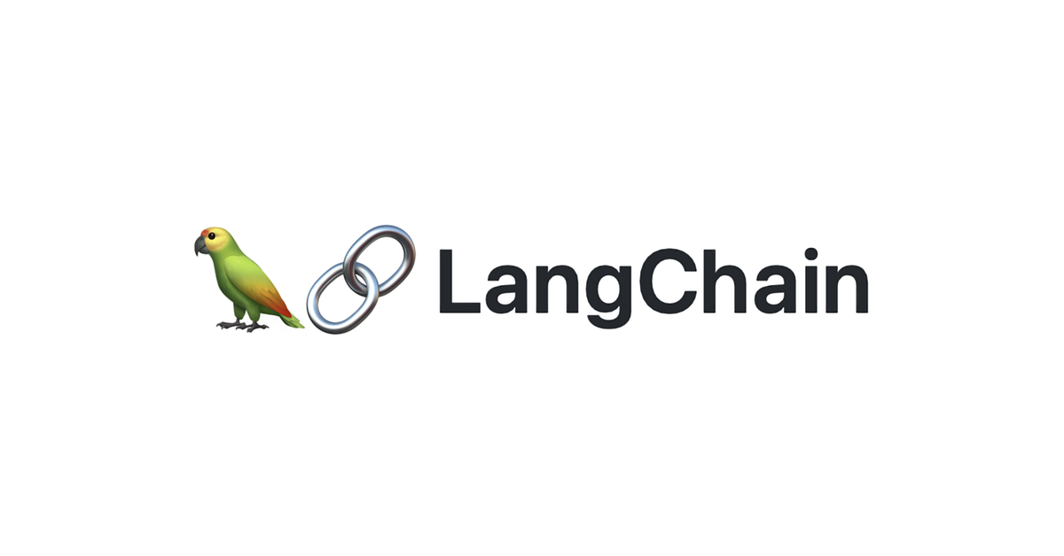
RAG from scratch: Overview
Lance Martin
Software Engineer, LangChain
@RLanceMartin
Notes:
LLMs are a powerful new platform, but they are not always trained on data that is relevant for our tasks. This is where retrieval augmented generation (or RAG) comes in: RAG is a general methodology for connecting LLMs with external data sources. It allows LLMs to use external data in generation of their output. This video series will build up an understanding of RAG from scratch, starting with the basics of indexing, retrieval, and generation. It will build up to more advanced techniques to address edge cases or challenges in RAG. See this notebook for code: https://github.com/langchain-ai/rag-from-scratch/blob/main/rag_from_scratch_1_to_4.ipynb

Slide 2
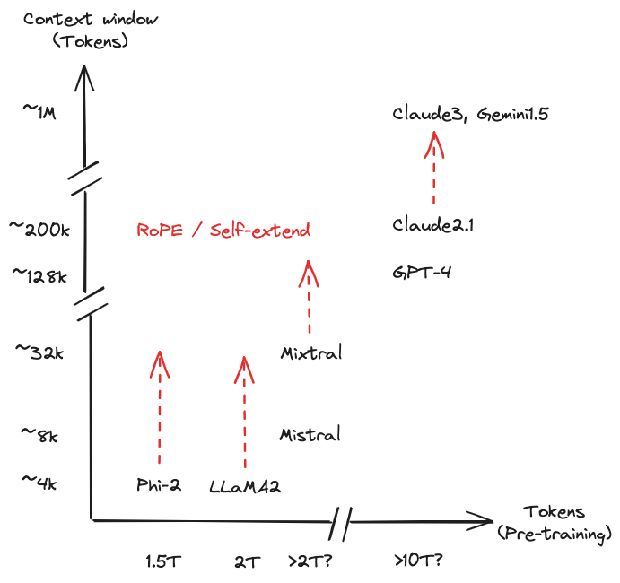
> 95% of the world’s data is “private”, but we can “feed it” to LLMs
https://huggingface.co/blog/mixtral
https://x.com/RihardJarc/status/1778082161595208124
Notes:
LLMs have been trained on a large corpus of public data, ~2T token (LLaMA) or beyond for proprietary models.
But they have not been trained on private or proprietary data.
But, they do give us an opening, or “context window”, that allows us to feed external information in (~a few dozen to ~a few hundred pages).

Slide 3
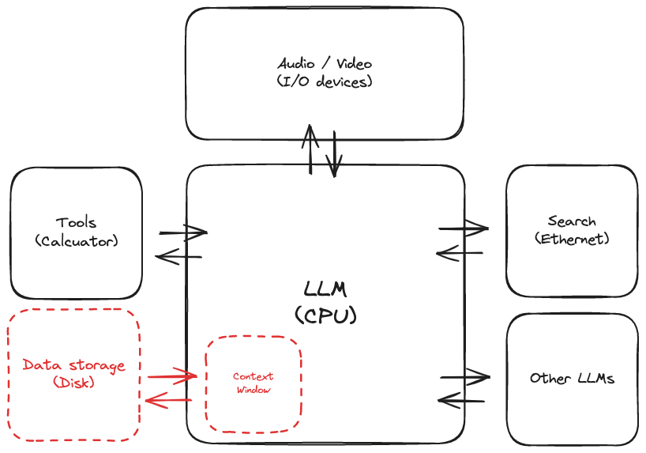
Connecting LLMs to external data is a central need
https://x.com/karpathy/status/1707437820045062561?s=20
Notes:
Connecting LLMs to external data sources is a central need, if we think about LLMs as a new kind of operating system.

Slide 4
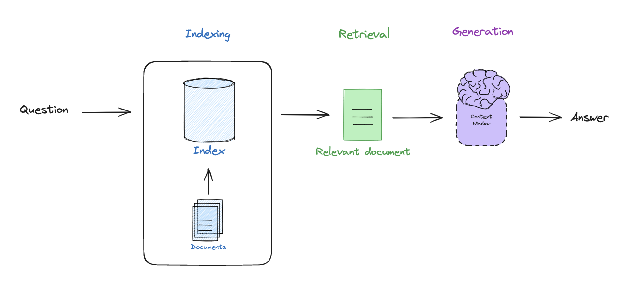
Retrieval Augmented Generation
Notes:
RAG is a general methodology to connect LLMs to external data, using (1) indexing (make external data retrievable), (2) retrieval (fetch external data that is relevant to a query that we want the LLM to reason about, (3) generation pass this to an LLM to generate an answer.

Slide 5
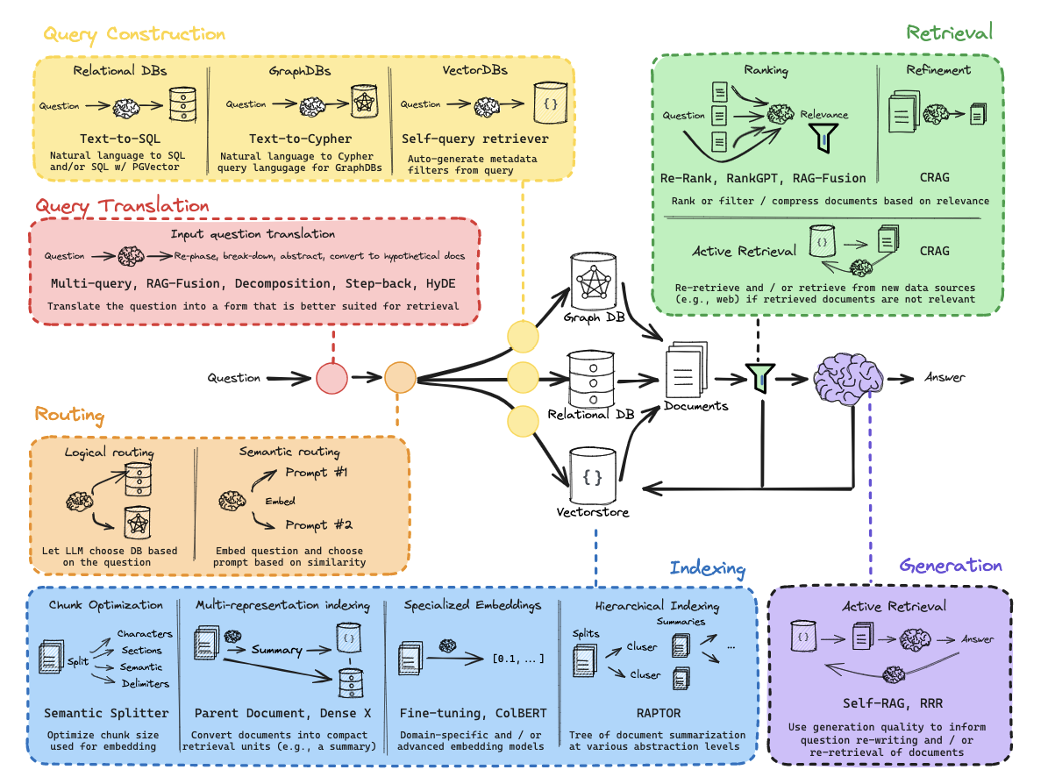
We’ll start from scratch, and build up to state of the art in RAG
Notes:
Over this series, we’ll deep dive into various SOTA methods to address problems in RAG. We’ll build up to a holistic understanding, which we can see here.

Slide 6
Outline
Basics
Indexing
Retrieval
Generation
Advanced
Query transformations
Routing
Query construction
Indexing
Retrieval
Generation
Notes:
In this series of short videos, we’ll start with the basics. But this is just the start. A lot of edge cases and problems arise.

Slide 7
Code walk-through

